Slide 1
TECHNOLOGY OVERVIEW
Presented by
Sachin Acharya
Manish pudasaini
Suraj Phaiju
Sanjay Thami
Saramsha Thapa

Slide 2
AGENDA
Public Switched Telephone Networks(PSTN)
Integrated Services Digital Network(ISDN)
Frame Relay
DSL and ADSL
VoIP
Bluetooth
Wi-fi
WiMax
GSM
3G
4G
NFC

Slide 3
Public Switched Telephone Network
Circuit switched Network.
It is the aggregate of world’s circuit- switched telephone network that are operated by national, regional or local telephone operators.
It is now entirely digital in its core network and includes mobile and other networks.
In relation to Internet, the PSTN actually furnishes much of the Internet’s long distance infrastructures.

Slide 4
ISDN
Set of CCITT/ITU standards for digital transmission over ordinary telephone copper wire as well as over other media.
Requires adapters at both ends of the transmission.
ISDN are two types.
B-Channel
D-channel

Slide 5
Frame Relay
High performance WAN protocol that operates at the physical and data link layer of the OSI reference model.
It is a packet switching telecommunication services designed for cost efficient data transmission for intermittent traffic between local area networks and between endpoints in wide area networks.
It was designed for use across ISDN interfaces.
Today, it is used over a variety of other network interfaces as well.
Simplified form of packet switching.

Slide 6
DSL
Technology for bringing high bandwidth information to homes and small business over ordinary copper telephone lines.
xDSL refers to different variations of DSL, such as ADSL, HDSL and RADSL.
Technology that assumes digital data does not require change into analog form and back.
Many DSL technologies implement as Asynchronous Transfer Mode low level bitstream layer to enable the adaptation of a number of different technologies.
DSL implementations may create bridged and or routed networks.

Slide 7
ADSL
Type of DSL.
Form of DSL that is most familiar to home and small business users.
It is called “asymmetric” because most of its two-way or duplex bandwidth is devoted to the downstream direction, sending data to its user.
Only small portion of bandwidth is available for upstream.

Slide 8
Voice Over Internet Protocol (VoIP)
Form of communication that allows us to make phone calls over a Broadband internet connection.
Method for routing voice calls across the internet, instead of the PSTN.
It allows us to call others who are also receiving calls over the internet.
Interconnected VoIP is a form of communication that allows us to make and receives call to and from traditional landline numbers.

Slide 9
Bluetooth
Bluetooth is a similar radio-wave technology, but it's mainly designed for communicating over short distances less than about 10m to 30ft.
We might use it to download photos from a digital camera to a PC, to hook up a wireless mouse to a laptop, to link a hands-free headset to your cellphone so you can talk and drive safely at the same time, and so on.
Electronic gadgets that work this way have built-in radio antennas (transmitters and receivers) so they can simultaneously send and receive wireless signals to other Bluetooth gadgets.

Slide 10
Piconet
A piconet is the type of connection that is formed between two or more Bluetooth-enabled devices such as modern cell phones or PDAs.
when a piconet is formed between two or more devices, one device takes the role of 'master', and all other devices as a 'slave' role for synchronization reasons.
A slave may only communicate with the master and may only communicate when granted permission by the master.
A slave may only communicate with the master and may only communicate when granted permission by the master.

Slide 11
Scatternet
A scatternet is a number of interconnected piconets that supports communication between more than 8 devices.
Scatternets can be formed when a member of one piconet (either the master or one of the slaves) elects to participate as a slave in a second, separate piconet.
Scatternets have the potential to bring the interconnectivity of the Internet to the physical world through wireless devices.
Scatternets can also be used to enable ad hoc communication and interaction between autonomous robots and other devices.

Slide 12
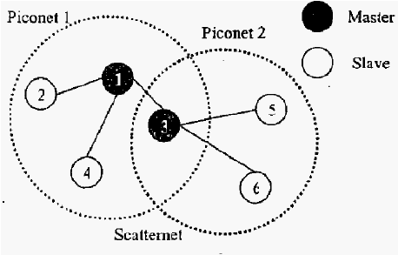
Fig : Piconet and Scatternet.

Slide 13
Wi-Fi.
WiFi is a technology that uses radio waves to provide network connectivity.
A WiFi connection is established using a wireless adapter to create hotspots - areas in the vicinity of a wireless router that are connected to the network and allow users to access internet services.
WiFi provides wireless connectivity to your devices by emitting frequencies between 2.4GHz - 5GHz, based on the amount of data on the network.
Many people us WiFi or 802.11 networking, to connect their computers at home, and some cities are trying to use the technology to provide free or low-cost Internet access to residents.
Wireless networks are easy to set up and inexpensive.

Slide 14
WiMax
WiMAX is one of the hottest broadband wireless technologies around today.
WiMAX systems are expected to deliver broadband access services to residential and enterprise customers in an economical way.
WiMAX would operate similar to WiFi, but at higher speeds over greater distances and for a greater number of users.
Based on Wireless MAN technology.

Slide 15
GSM (Global System for Mobile communication)
GSM (Global System for Mobile communication) is a digitalmobile telephony system.
GSM digitizes and compresses data, then sends it down a channel with two other streams of user data, each in its own time slot.
It operates at either the 900 MHz or 1800 MHz frequency band.

Slide 16
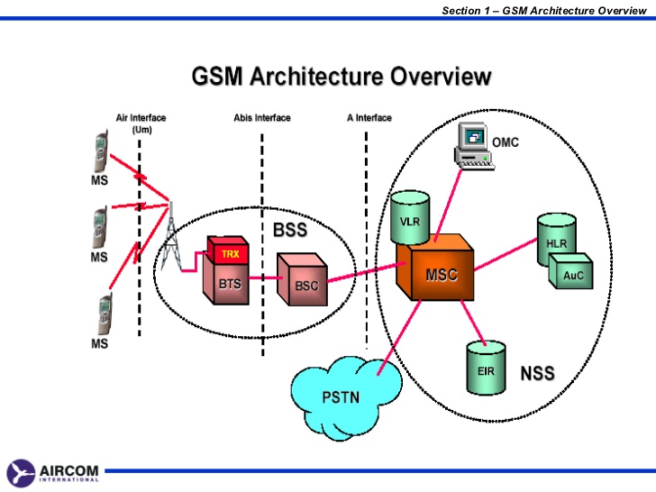
GSM architecture overview

Slide 17
3G
3G is the mobile broadband revolution
This network combines aspects of the 2Gnetwork with some new technology.
The system also involves significant algorithmic and mathematical improvements in signal transmission.
These protocols have an improved transport layer by a complex arrangement of physical layer channel.

Slide 18
4G
4G network is based on LTE-Advanced – 3GPP Long Term Evolution.
This new network boosts peak downloads speeds up to 100Mbps and 50Mbps upload .
4G bandwidth is critical in supporting high speed and a high number of users.

Slide 19
NFC
Very short range wireless technology aimed at transferring a small amount of data.
It can transmit data at high speed.
Based on contactless card and RFID technology and is to large extent compatible with them.
Set of communication protocol that enable two electronic devices.
Able to establish a peer-to-peer link with another device.

Slide 20
Reference
Er.Marut Dhungana Data communication and computer network.
https://en.wikipedia.org/wiki/Public_switched_telephone_network
http://searchenterprisewan.techtarget.com/definition/frame-relay
https://en.wikipedia.org/wiki/DSL_modem
https://en.wikipedia.org/wiki/Voice_over_IP
https://en.wikipedia.org/wiki/Bluetooth
https://en.wikipedia.org/wiki/Wi-Fi
https://en.wikipedia.org/wiki/Near_field_communication

Slide 21
THANK YOU !!!

